Slide 1

Spotted Python
Week 7 Tutorial
BPT Diagram
Reading papers
Finding papers
Overleaf
LaTeX Packages

Slide 2
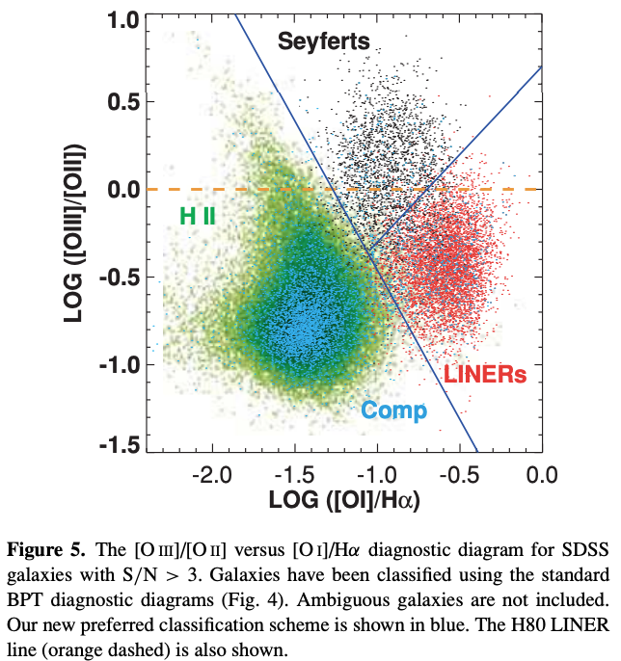

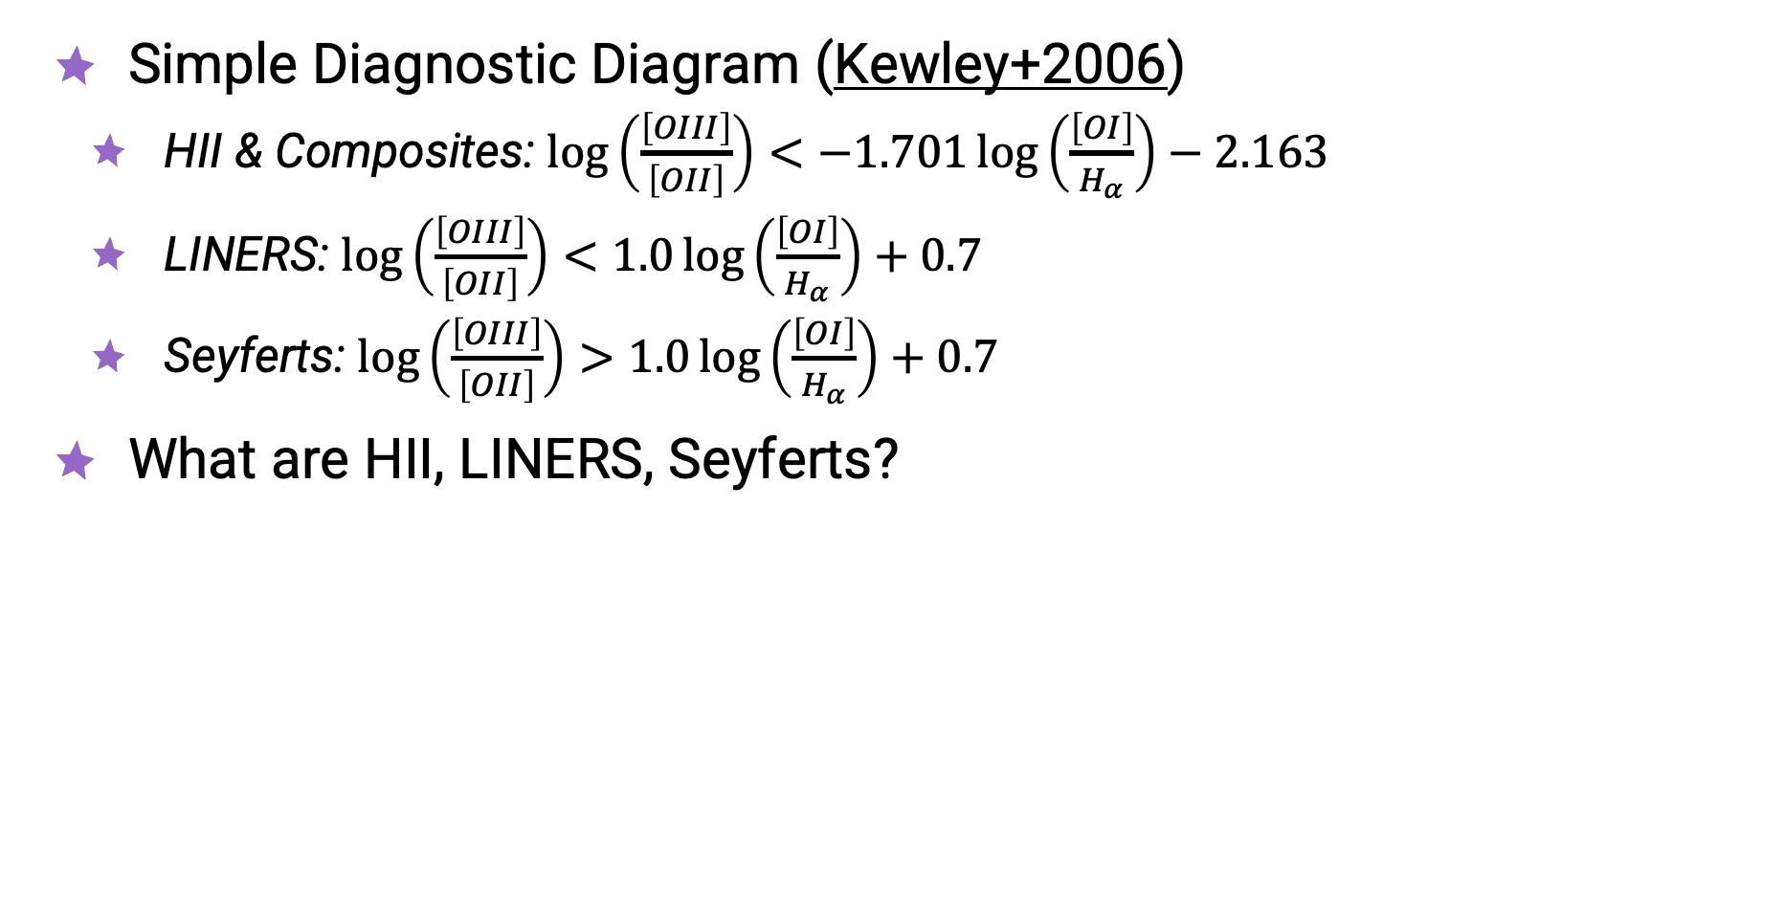
BPT Diagram
Simple Diagnostic Diagram (Kewley+2006)
  HII & Composites: $\log\left(\frac{\left[OIII\right]}{\left[OII\right]}\right)<−1.701\log\left(\frac{\left[OI\right]}{H_{α}}\right)−2.163$
  LINERS: $\log\left(\frac{\left[OIII\right]}{\left[OII\right]}\right)<1.0\log\left(\frac{\left[OI\right]}{H_{α}}\right)+0.7$
  Seyferts: $\log\left(\frac{\left[OIII\right]}{\left[OII\right]}\right)>1.0\log\left(\frac{\left[OI\right]}{H_{α}}\right)+0.7$
What are HII, LINERS, Seyferts?

Slide 3
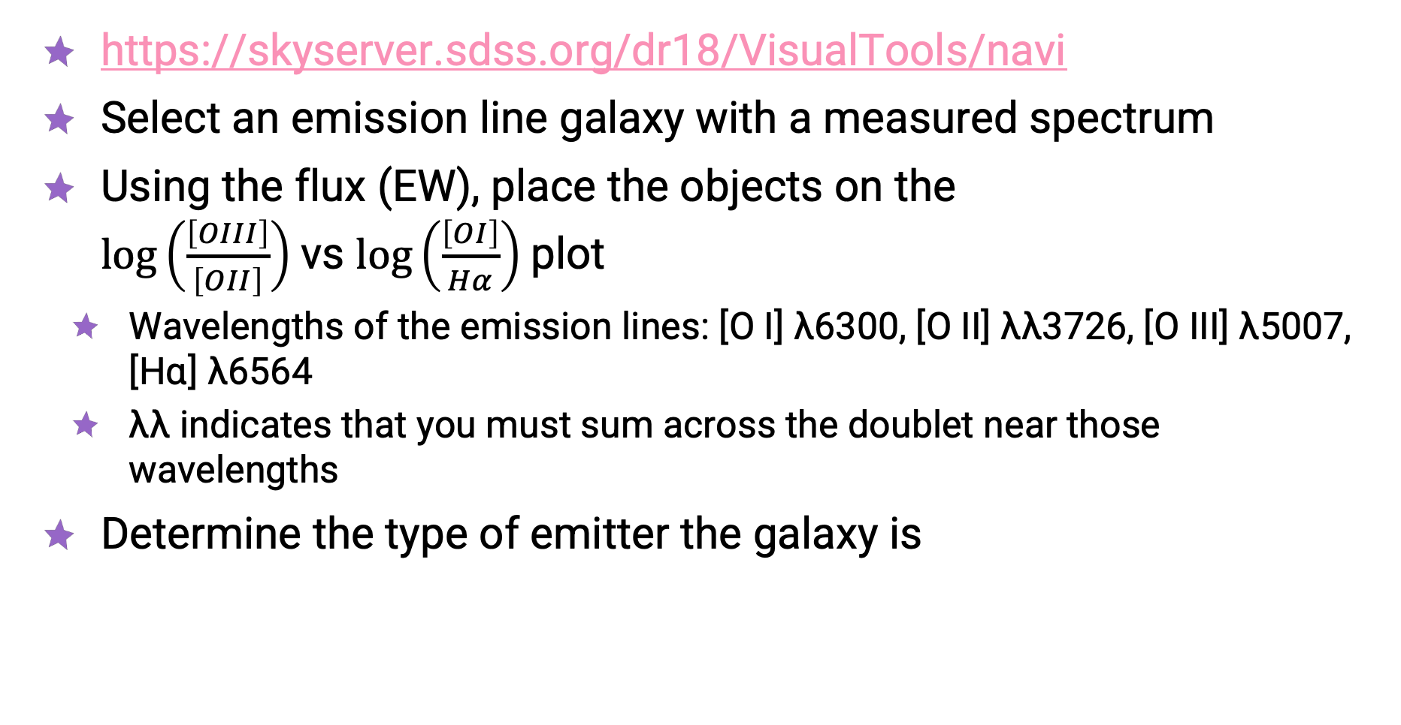
SDSS Navigate Visual Tool
https://skyserver.sdss.org/dr18/VisualTools/navi
Select an emission line galaxy with a measured spectrum
Using the flux (EW), place the objects on the
$\log\left(\frac{\left[OIII\right]}{\left[OII\right]}\right)$vs $\log\left(\frac{\left[OI\right]}{Hα}\right)$plot
  Wavelengths of the emission lines: [O I] λ6300, [O II] λλ3726, [O III] λ5007,
  [Hɑ] λ6564
  λλ indicates that you must sum across the doublet near those wavelengths
Determine the type of emitter the galaxy is

Slide 4
Reading a paper
Order to read a paper:
  Abstract
  Figures
  Conclusions
  Introduction
  The rest
Identification of an [α/Fe]—Enhanced Thick Disk Component in an Edge-on Milky Way Analog
  https://iopscience.iop.org/article/10.3847/2041-8213/abfc57
Let’s start reading!

Slide 5
Finding and storing papers
ADS/NASA
  https://ui.adsabs.harvard.edu/
ArXiv
  https://arxiv.org/
Pathfinder
  https://huggingface.co/spaces/kiyer/pathfinder
Zotero
  https://www.zotero.org/
Let’s decide your pairs for the presentation!

Slide 6
LaTeX and Overleaf
preferable typesetting software in academic writing
For your written report, you must use LaTeX in either the PASA or MNRAS journal style
  Log into overleaf
  New Project → Templates → View All
  Search either PASA (Cambridge) or MNRAS
UNSW provides free Pro accounts, so make sure to sign up using your university email

Slide 7
How do I start using LaTeX
https://www.overleaf.com/learn/latex/Tutorials
Sections
  \begin{section}
  \end{section}
Lists (ordered and unordered)
  \begin{itemize} or \begin{enumerate}
  \end{itemize} or \end{enumerate}
Images (including captions)
  \begin{figure}
  \end{figure}

Slide 8
How do I start using LaTeX
Tables
  Use table generators (e.g. https://www.tablesgenerator.com/)
Equations (including the Physics package)
  https://www.overleaf.com/learn/latex/Mathematical_expressions
Code
  \begin{lstlisting}[language=Python]
  \end{lstlisting}
References
  Export from Zotero and upload

Slide 9
Setting up your document
Create a folder for your figures, tables, and sections
Import all the packages you require, for example:
  \usepackage{graphicx}
  \usepackage{amsmath}
  \usepackage{listings}
Have a clear storyline
Figure captions go below, and table captions go above
All captions must include the takeaway message of the figure and include all details required for a reader’s understanding

